Slide 1
Actor Concurrency Model
GEDex Day (Nov 12)
Bill Cheung
Brilly Tsang
Group Technology

Slide 2
Goal

Slide 3
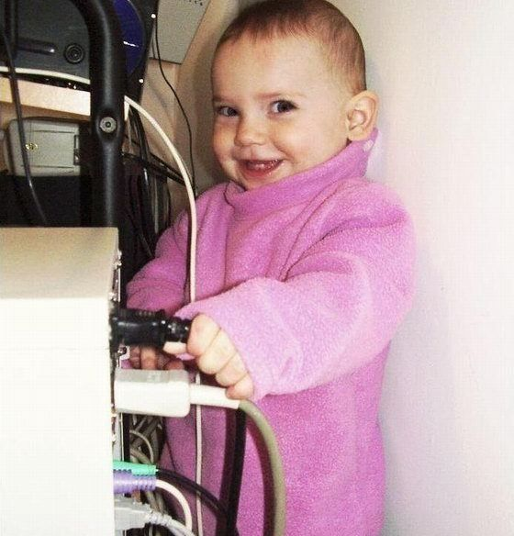
Why do we care?
Provides a reliable data tier with a single, consistent view of data
Enables dynamic data capacity including fault tolerance and load balancing
Ensures that data capacity scales with processing capacity

Slide 4
What is Actor?
1973 Historical Paper
Popularize by Erlang
Scala and JVM

Slide 5
Actor and Scala

Slide 6
Akka – The Good, the Bad and the Ugly
Mature, good documentation
Paddling their ware such as installing their whole stack
Clumsy tutorial
Not really design for Java as a fundamental lang in mind

Slide 7
Scenarios
Computational intensive – Monte Carlo Simulation for Option TV
I/O Intensive - ???

Slide 8
Result discussion
Scale
code comparison

Slide 9
What you need to be aware of?
Test the scalability of different vendors
What hardware, software and language requirements are
How do they perform in WAN/LAN when someone kick the network cable and separated the cluster?
Requirements for object to be store in the grid
Supporting frameworks such as analytics, monitoring, transaction management and events processing

Slide 10

General Discussion
Any war stories related to In Memory Data Grid?
Do you think this is relevant to your project?
How can this simplify single application, distributed data and infrastructure setup?

